Slide 1

GLA UNIVERSITY MATHURA
MINI PROJECT : AI DESKTOP ASSISTANT
MADE BY : AMAN,ASHISH SHARMA
ROLL NO. : (201500071) (201500166)
SEC: K

Slide 2
What can this A.I. assistant do for you? • It can send emails for you. • It can play music for you. • It can do Wikipedia searches for you. • It is capable of opening websites like Google, Youtube, etc., in a web browser. • It is capable of opening your code editor or IDE with a single voice command.

Slide 3
MODULES USED: HERE ARE SOME OF THEM USED IN THE CODE.
MODULES USED
Subprocess:- This module is used for getting system subprocess details which are used in various commands i.e Shutdown, Sleep, etc. This module comes buit-in with Python.
Pyttsx3:- This module is used for conversion of text to speech in a program it works offline. To install this module type the below command in the terminal.
pip install pyttsx3.
Wikipedia:- As we all know Wikipedia is a great source of knowledge just like Geeks for Geeks we have used Wikipedia module to get information from Wikipedia or to perform Wikipedia search. To install this module type the below command in the terminal.
Speech Recognition:- Since we’re building an Application of voice assistant, one of the most important things in this is that your assistant recognizes your voice (means what you want to say/ ask). To install this module type the below command in the terminal.

Slide 4
What is pyttsx3?
A python library which will help us to convert text to speech. In short, it is a text-to-speech library. It works offline,and it is compatible with Python 2 as well the Python3
Then, install pypiwin32 by typing the below command in the terminal : pip install pypiwin32.

Slide 5

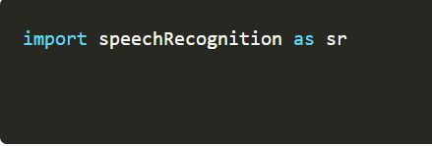
Defining Take command Function :
The next most important thing for our A.I. assistant is that it should be able to take command with the help of the microphone of the user's system. So, now we will make a takeCommand() function. With the help of the takeCommand() function, our A.I. assistant will be able to return a string output by taking microphone input from the user.
Before defining the takeCommand() function, we need to install a module called speechRecognition. Install this module by:

Slide 6
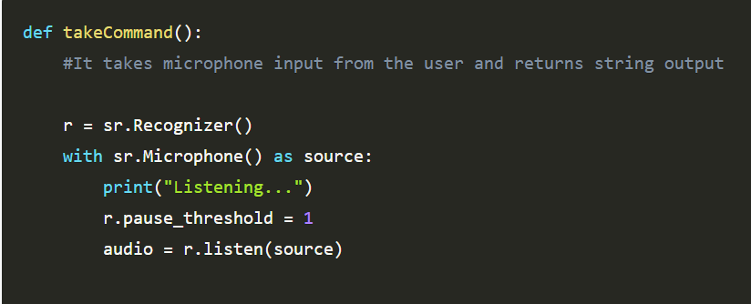
TAKE COMMAND FUNCTION:

Slide 7
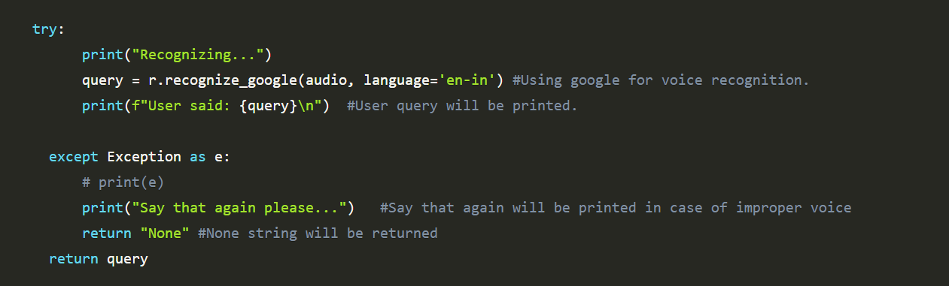
SETTING THE SPEECH RECOGNITION:

Slide 8

Defining Task 1: To search something on Wikipedia
To do Wikipedia searches, we need to install and import the Wikipedia module into our program. Type the below command to install the Wikipedia module :

Slide 9
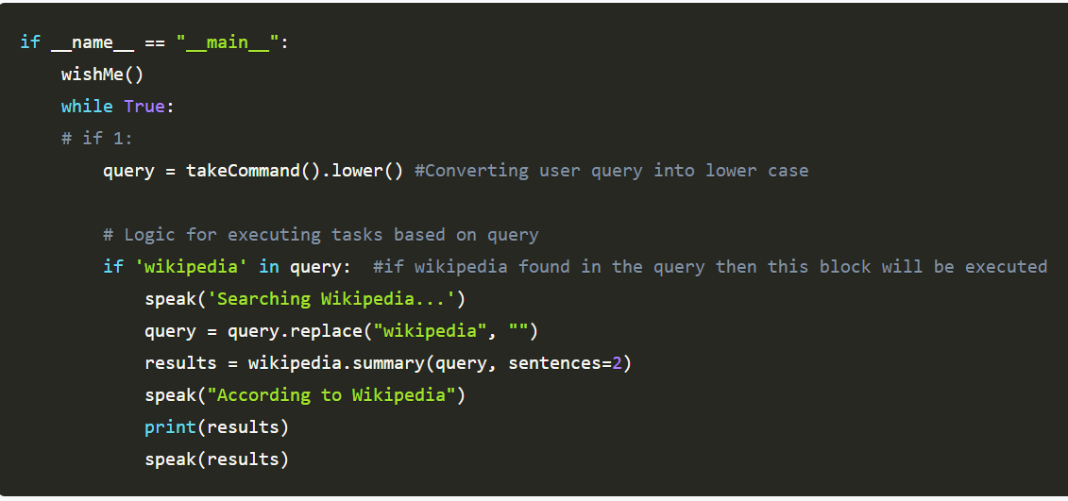

Slide 10
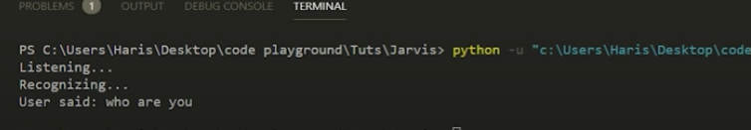
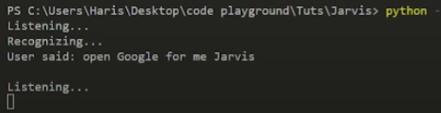
SAMPLE OUTPUT:

Slide 11

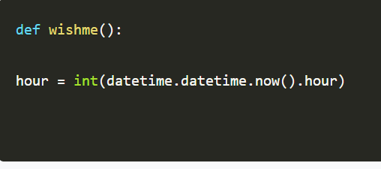
FUNCTION FOR WISHING

Slide 12
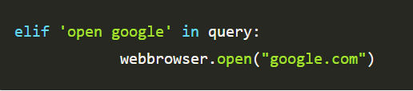
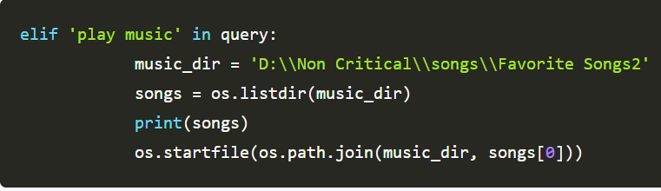
QUERY FOR BROWSER AND PLAYING MUSIC.

Slide 13
THANK YOU

